Slide 1

Interim results from CLASSICAL-Lung, phase 1b/2 Study of pepinemab (VX15/2503) in combination with avelumab in advanced NSCLC
Jonathan W. Goldman, MD – UCLA, Santa Monica, CA
Jonathan W. Goldman, Terrence L. Fisher, Elizabeth Evans, John E. Leonard, Desa Rae Pastore, Crystal Mallow, Ernest Smith, Andreas Schröder, Kevin Chin, Michael Shafique, Thaddeus Beck, Megan A. Baumgart, Ramaswamy Govindan, Nashtat Gabrail, Rachel E. Sanborn, Alexander I. Spira, Nagashree Seetharamu, Yanyan Lou, Aaron S. Mansfield, and Maurice Zauderer.

Slide 2
Funding
This study was sponsored by Vaccinex in collaboration with Merck KGaA, Darmstadt, Germany and Pfizer.
Disclosures
Jonathan Goldman, MD
Research Grant: Array, Astra Zeneca/MedImmune, BMS, Genentech/Roche, Merck, Pfizer, Vaccinex
Consulting Fees: Astra Zeneca, BMS, Genentech, Pfizer
Speakers Bureau: Merck

Slide 3
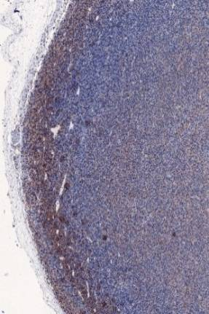
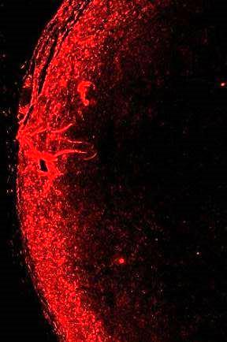
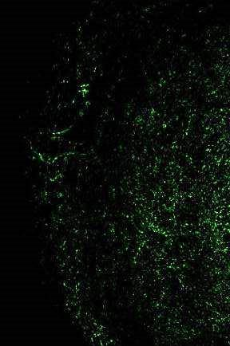
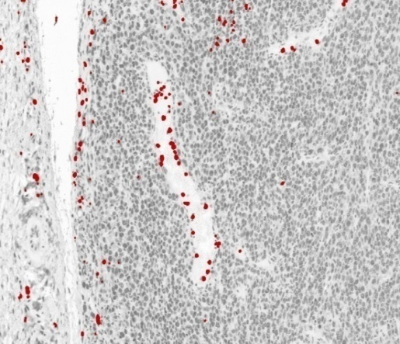
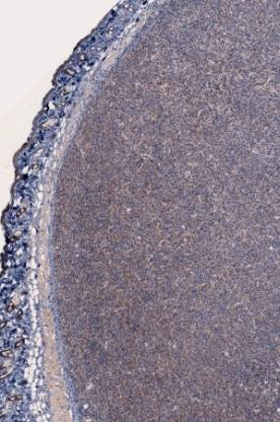
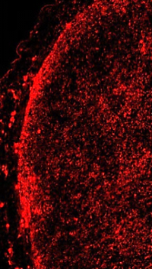
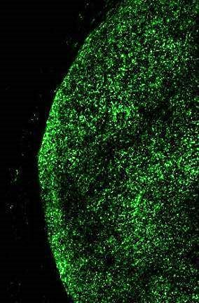
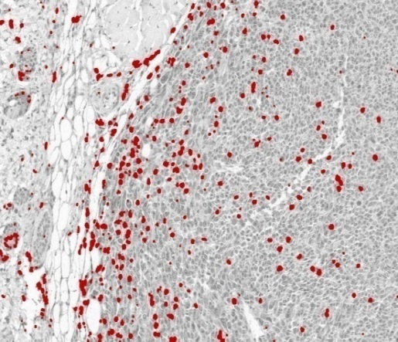
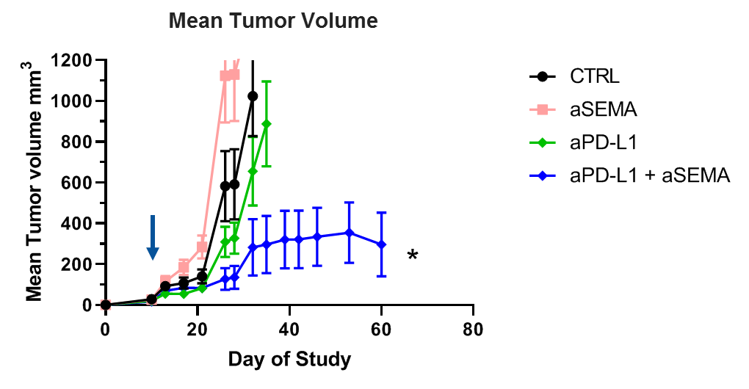
Anti-SEMA4D shifts balance of chemokines and suppressor cells to enhance infiltration and activity of tumoral T cells
Preclinical Model - Colon26
1
Dendritic cells (DC) express high affinity receptor PLXNB1 and CD11c+ (red stain).
2
Binding to SEMA4D at tumor edge restricts penetration of PLXNB1+ DC into tumor.
3
Shift in balance of immune cells and factors, facilitates CD8+ T cell infiltration
4
Enhance immune checkpoint therapies
[
Control IgG
(vessel)
SEMA4D
CD11c
F4/80
CD8+ CTL
anti-PD-L1 Combination: Colon26
αSema4D Mab67
The Sema4D gradient is neutralized
Inflammatory DC’s migrate into tumor
Increase in Pro-inflammatory APC
Increase in CD8+ T cell infiltration and activity
Evans EE et al. Cancer Immunol Research 2015;3(6): 689-701
http://www.ncbi.nlm.nih.gov/pubmed/25614511
Notes:
Pre-clinical studies – SEMA4D at the invasive margin
An illustration of how this works at the level of the TME.
CD11c dendritic cell marker
APC (proinflammatory macrophage) F4/80 - result of migration or differentiation
CD8+ cell infiltrate is recruited by proinflammatory environment
Tcells don’t have the receptor, direct action on the myeloid component

Slide 4
Phase 1b/2 CLASSICAL- Lung Study Design
Combination Trial of Pepinemab with Avelumab in NSCLC
5 mg/kg
(n=3)
20 mg/kg
(n=3)
IO Failure
10 mg/kg
(n=32)
IO Naive
10 mg/kg
(n= 18)
10 mg/kg
(n=6)
Phase 1b
Dose Escalation
IO Naïve
(n=12)
pepinemab
+
10 mg/kg
avelumab
Q2W
Phase 2
Dose Expansion
(n=50)
Study Objectives
The primary objective is safety, tolerability, and identification of the RP2D for dose expansion.
Secondary objectives include evaluation of efficacy, immunogenicity, and PK/PD, and an exploratory objective is to identify candidate biomarkers of activity
Notes:
Note the RP2D – 10 mg/kg
PK/PD reasoning again
10 mg/kg = saturation of the target on peripheral mononuclear cells; in other studies, saturates target in the tumor

Slide 5
Demographics
Safety
The combination therapy of pepinemab plus avelumab is well tolerated at all dose levels; no concerning safety signals identified to date.
One DLT, a grade 3 pulmonary embolism, occurred in the 10mg/kg pepinemab + 10mg/kg avelumab escalation cohort, resolved and did not recur in that same subject or additional subjects in any cohort.
The most frequent related AEs still remain at grades 1 or 2 fatigue, pyrexia, or chills.
Two (2) Immune Related Adverse Event (irAE) occurred during the Expansion Cohort (immune related myositis and immune mediated pneumonitis).
No deaths (grade 5) have been reported that were related to study treatment (pepinemab and avelumab) (14 Jan 2020)
Overall immunogenicity does not appear to be a concern with this combination.
PD-L1 neg/ low
4 subjects still on study: 2 ION / 2 IOF

Slide 6
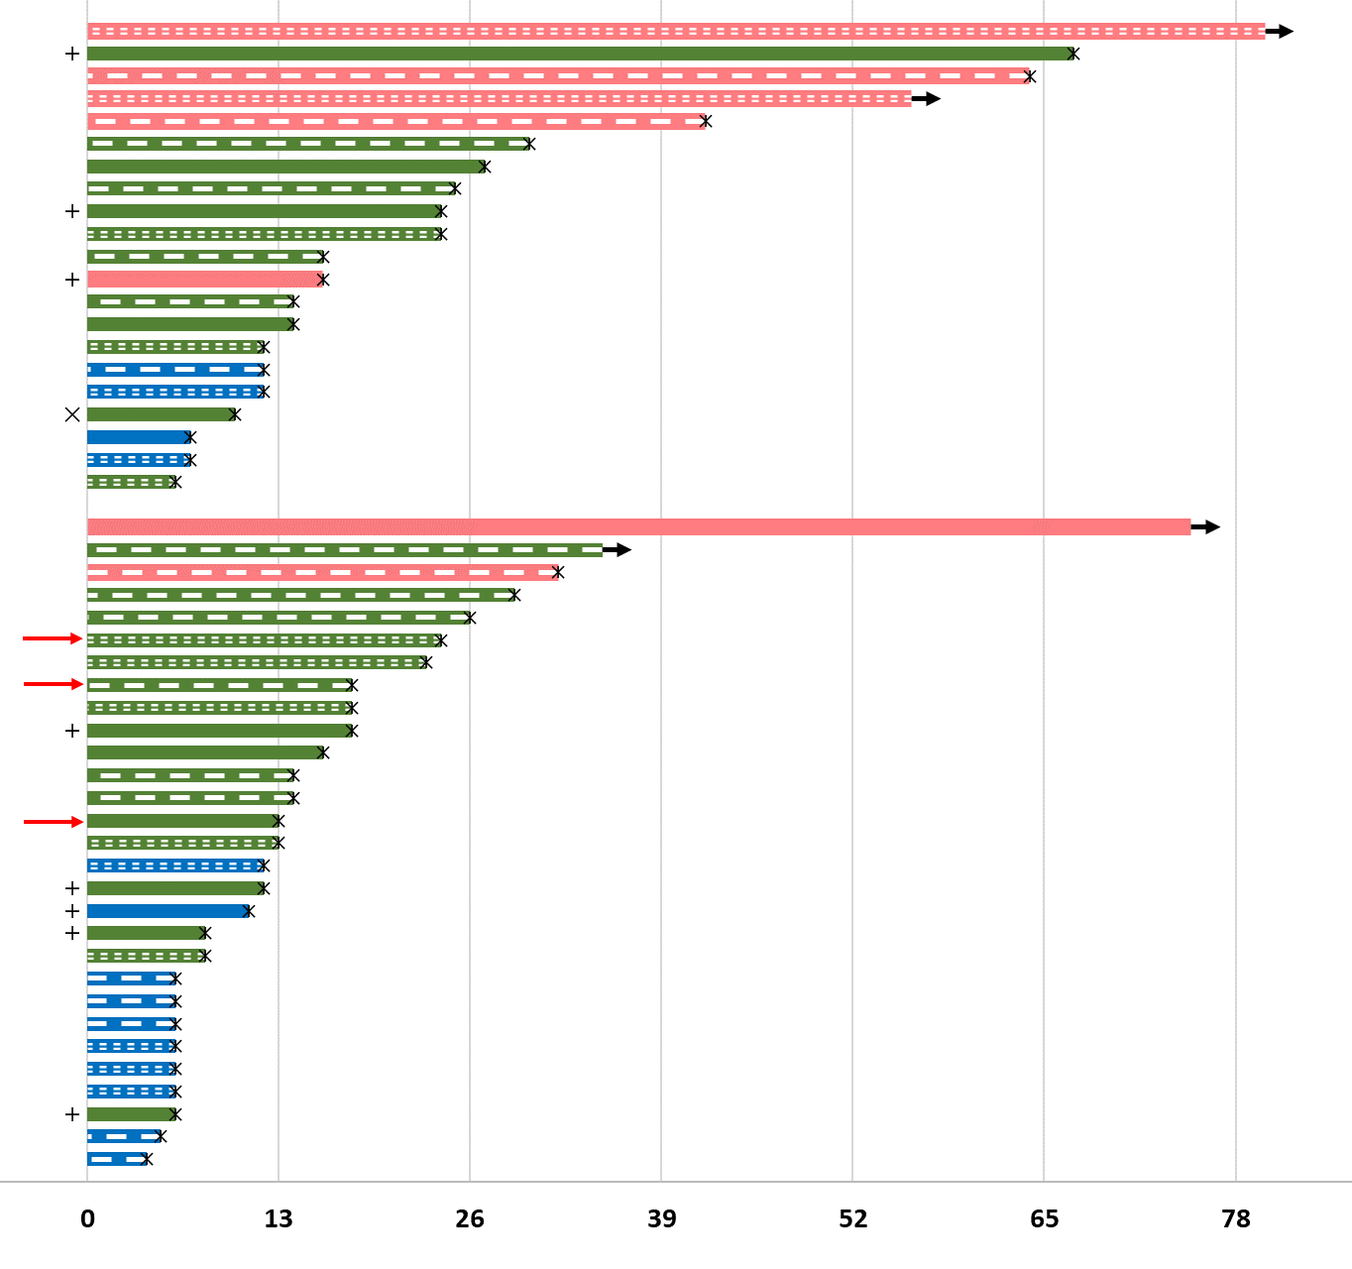
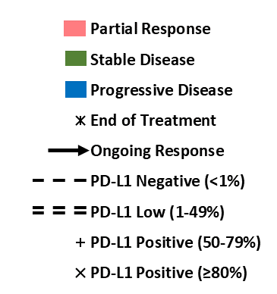
Time on Study in Evaluable Subjects
IO Naïve Subjects
81% of evaluable patients (17/21) have experienced disease control (PR+SD) while receiving the combination.
Durable clinical benefit of ≥1 year has been achieved in 4 subjects and ≥6 months in 6 subjects
97% of PR & SD subjects were reported to have Negative or Low PD-L1 expression*
++
IO Failure Subjects
59% of evaluable patients (17/29) whose tumors had progressed during or following treatment with anti-PD-x antibodies benefited from switching to the combination therapy, which appears to induce a halt or reversal of tumor progression.
Three (3) subjects were IO primary refractory before entering trial ( )
Two (2) subjects who failed pembro have attained PRs with 65% and 52% tumor reduction at most recent scan.
Durable response of ≥1 year has been achieved in 1 subject and ≥6 months in 5 subjects
++
*PD-L1 analysis was performed via Dako 73-10 pharmDx. PD-L1 status was available for 51/62 subjects. A total of 29 SD and PR subjects were analyzed and 28 were reported to be PD-L1 negative or low (0-80%); 10 of these were PD-L1 negative (<1%).
Weeks

Slide 7
CLASSICAL- Lung: IO Failure
Tumor (Cytokeratin+)
CD8+ T cells
Pembrolizumab refractory
Increase in CD8+ T cell infiltration
PR
SD
PD
002-012 | 002-025 | 002-016 | 002-015 | 002-019 | 007-002 | 007-003 | 002-034 | 002-013
Pre-Treatment
On-Treatment
CD8 Density
NE
No or low tumor detected in these 2 biopsies from patients with PR
No tumor detected in these 3 biopsies from patients with stable disease
 | 71 | 32 | 23 | 18 | 26 | 16 | 18 | 11 | 6
Weeks on Study:
Notes:
Quantification of tumor bed across the entire biopsy section, excluding necrotic regions. Tumor bed was verified by pathologist review
Same lesion was biopsied; cores; about 5 week intervals
Overall, on-treatment biopsies have less green tumor and more CD8 T cells infiltrating tumor bed in patients with PR
Even those with SD, have scant CK staining on on treatment biopsies with increases in CD8+ infiltrating T-cells
(except PDs) – where you see a trend to decreasing CD8+ with increase in CK staining
Representative images, and graphs below represent quantification of entire scan of tumor bed contained within each biopsy (excluding necrotic regions)
Question for another time – accuracy, appropriateness of RECIST in assessing responses

Slide 8
Summary
Anti-SEMA4D shifts the immune balance in the TME to overcome immune exclusion and myeloid suppression
  Increased T cell penetration and T cell activity
  Reduced myeloid cells and reduced immune suppression
The combination of pepinemab + avelumab is well tolerated in CLASSICAL-Lung trial.
Extent and duration of treatment benefit.
  ION: 5 immunotherapy naïve patients experienced a PR, 4 patients have durable benefit over 1 year, and the Disease Control Rate (PR+SD) was 81%. (n=21 evaluable subjects enrolled in either dose escalation or dose expansion)
    Quality of enrollment in this cohort suffered from 30% non-evaluable and low PD-L1 expression.
  Notably, clinical response or disease stabilization was observed in majority of patients despite low PD-L1 expression.
    97% (28/29) of all subjects with either PR or SD subjects were reported to have negative or low positive PD-L1 expression (Dako 73-10 pharmDx assay)
  IOF: 59% of evaluable patients (17/29) whose tumors had progressed during or following treatment with anti-PD-x antibodies benefited from switching to the combination of pepinemab + avelumab, which appeared to induce a halt or reversal of tumor progression (PR or SD).
Exploratory:
  Increased CD8+ T cell density was observed in most tumors following treatment with pepinemab + avelumab. CD8+ T cell levels in tumor appear to correspond with response.
  Tumor was absent or greatly reduced in 10/11 biopsies from subjects analyzed with PR or SD. Interestingly, no tumor was detected in biopsies analyzed from 4/5 subjects with PR and 3/6 subjects with SD.

Slide 9
Please contact me with any questions:
Jonathan W Goldman, MD jwgoldman@mednet.ucla.edu
310-829-5471

